Slide 1
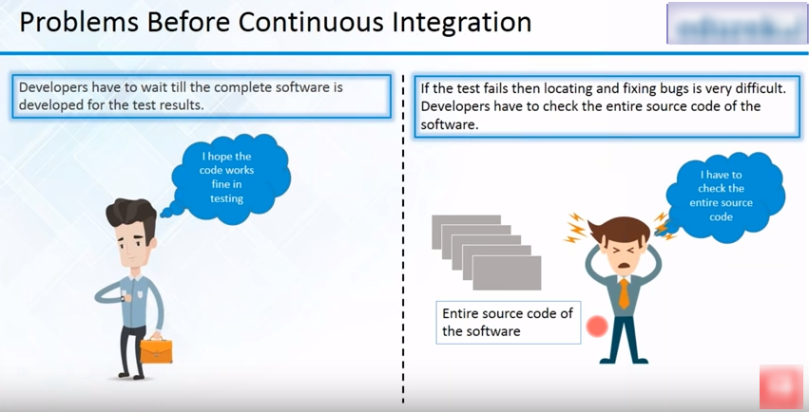
Automation in CI

Slide 2
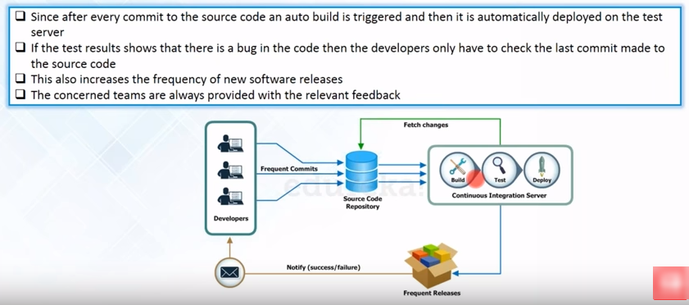

Slide 3
Continuous Integration or CI
It works on a strategy that ensures that everyone's changes integrate with the current version of the project.
This led to Catch Bugs.
It reduces Merge conflicts.
It helps in confidence that software is working.

